Slide 1
Combined Air Quality, Temperature, and Humidity Sensor
By: Rhushya KC, Rithvik Muthyalapati, Rohan S

Slide 2
Overview
For our project, we have designed and created an arduino circuit that when placed in an environment, will display important parameters such as the quality of the air, the temperature, and the humidity. We utilized the DHT11 component which consists of the temperature and humidity sensor, the MQ 135 component which consists of the air quality sensor, the I2C OLED display to display environmental readings, the LDR sensor module which detects day or night based on the brightness of the environment, and the Arduino Nano V3 to connect the sensors and display together. The programming would be done with Arduino IDE. Our product is advantageous in regards to ease of operation of our device to detect whether an environment is safe. By using Arduino IDE we aim to offer user-friendly solutions to the users. The significance of our product lies in its simplicity and ease of operation, allowing users to swiftly ascertain the safety of their surroundings. Through our collaborative efforts, we seek to contribute to the advancement of accessible and affordable environmental monitoring solutions. By fostering innovation and leveraging open-source platforms like Arduino, we aspire to create a positive impact on society by promoting awareness and facilitating informed decision-making regarding environmental well-being.

Slide 3
Components

Slide 4
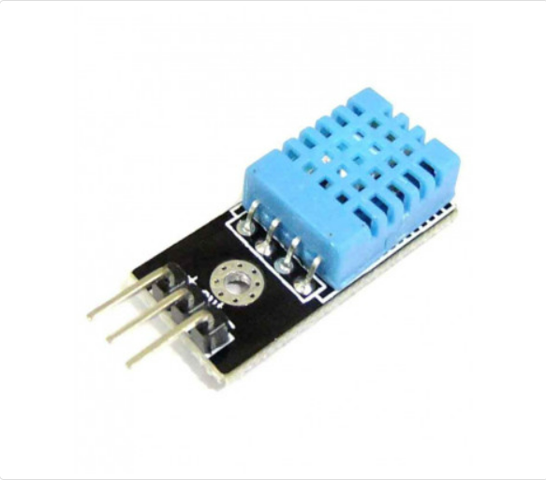
DHT11 Temperature and Humidity Sensor
Type: Combined temperature and humidity sensor
Measurement: Measures temperature and humidity
Output: Provides digital output (temperature and humidity values)
Accuracy:
Temperature: ±2°C
Humidity: ±5% RH
Range:
Temperature: 0°C to 50°C
Humidity: 20% to 90% RH
Operating Voltage: Typically operates at 3.3V or 5V
Application:
Commonly used in home automation systems for climate control
Widely employed in weather stations
Utilized in HVAC systems for monitoring temperature and humidity

Slide 5
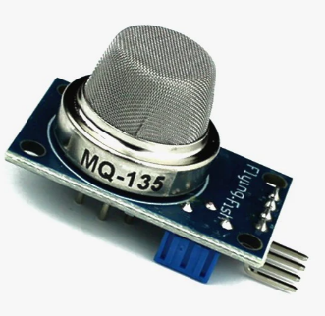
MQ135 Air Quality Sensor
Type: Air quality sensor
Measurement: Measures multiple gases such as NH3, NOx, alcohol, CO2, etc.
Output: Provides analog output, which varies based on the detected gases
Accuracy: Accuracy varies depending on the gas being detected
Range: Varies based on the gas being detected
Operating Voltage: Typically operates at 5V
Application:
Used in air quality monitoring systems.
Employed in indoor air quality monitoring in buildings and homes.
Utilized in environmental monitoring systems.

Slide 6
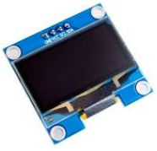
0.96’’ LCD OLED Display
Type: OLED (Organic Light Emitting Diode) display
Size: 0.96 inches
Communication Protocol: I2C (Inter-Integrated Circuit)
Resolution: 128 x 64 pixels
Color: Monochrome (usually white or blue)
Controller Chip: SSD1306
Viewing Angle: Wide viewing angle (>160 degrees)
Brightness: Bright and clear display
Operating Voltage: Typically operates at 3.3V or 5V
Interface: 4-wire SPI (Serial Peripheral Interface) or I2C
Driver Library: Available for Arduino, Raspberry Pi, and other microcontrollers
Application:
Used for displaying information in various projects, such as IoT devices, wearables, and small gadgets
Suitable for displaying sensor data, text, and simple graphics

Slide 7
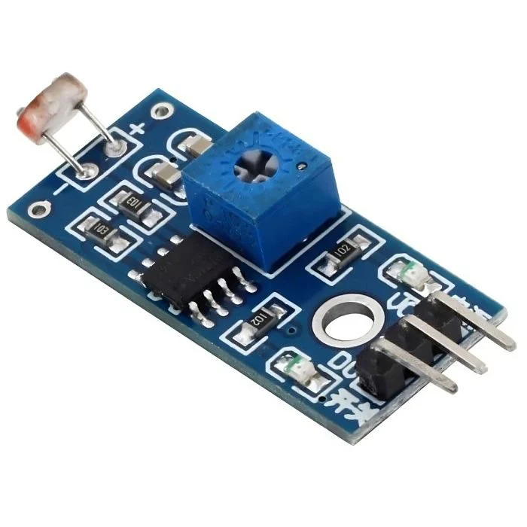
LDR Sensor
Type: Light-dependent resistor (LDR)
Measurement: Measures ambient light intensity
Output: Analog voltage output inversely proportional to light intensity
Accuracy: Depends on the sensor quality and calibration
Range: Typically 10k ohms to a few hundred ohms
Operating Voltage: Generally operates at 5V
Application:
Light sensing applications in automated lighting systems
Sunlight intensity monitoring for solar panel optimization
Darkness detection for security systems

Slide 8
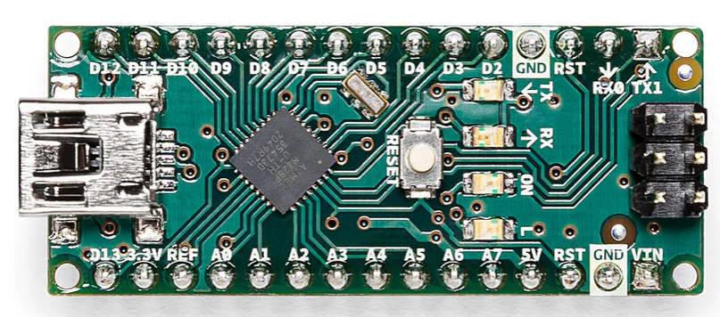
Arduino Nano V3
Type: Microcontroller board.
Microcontroller: Atmel ATmega328P
Clock Speed: 16 MHz
Digital I/O Pins: 14
Analog Input Pins: 8
Operating Voltage: 5V
Input Voltage (recommended): 7-12V
Input Voltage (limits): 6-20V
Flash Memory: 32 KB (of which 2 KB is used by bootloader)
SRAM: 2 KB
EEPROM: 1 KB
Communication: USB, UART, SPI, I2C
Dimensions: 18 x 45 mm
Application:
Used for prototyping, projects with space constraints, and applications where lower power consumption is preferred
Commonly used in robotics, automation, and IoT projects

Slide 9
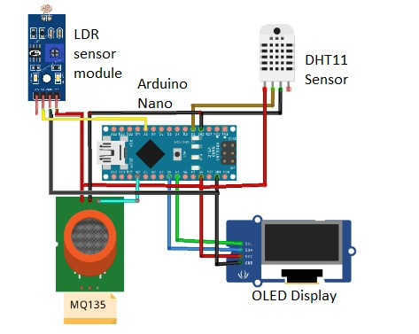
Circuit Diagram

Slide 10
Code

Slide 11
#include <DHT.h>
#include <DHT_U.h>
#include <SPI.h>
#include <Wire.h>
#include <Adafruit_GFX.h>
#include <Adafruit_SSD1306.h>
#include <Fonts/FreeSans9pt7b.h>
#include <Fonts/FreeMonoOblique9pt7b.h>
#include <DHT.h>
#define SCREEN_WIDTH 128 // OLED display width, in pixels
#define SCREEN_HEIGHT 64 // OLED display height, in pixels
#define OLED_RESET 4 // Reset pin # (or -1 if sharing Arduino reset pin)
Adafruit_SSD1306 display(SCREEN_WIDTH, SCREEN_HEIGHT, &Wire, OLED_RESET);
#define sensor A0
#define DHTPIN 2 // Digital pin 2
#define DHTTYPE DHT11 // DHT 11
#define DO_PIN 8
int gasLevel = 0; //int variable for gas level
String quality ="";
DHT dht(DHTPIN, DHTTYPE);
const unsigned char epd_bitmap_moon [] PROGMEM = {
0x00, 0x00, 0x07, 0xc0, 0x1f, 0xf0, 0x3f, 0xf8, 0x01, 0xf8, 0x00, 0xfc, 0x00, 0x7c, 0x00, 0x7c,
0x00, 0x7c, 0x00, 0x7c, 0x00, 0xfc, 0x01, 0xf8, 0x3f, 0xf8, 0x1f, 0xf0, 0x07, 0xc0, 0x00, 0x00
};
const unsigned char epd_bitmap_sun [] PROGMEM = {
0x01, 0x00, 0x41, 0x04, 0x21, 0x08, 0x13, 0x90, 0x0c, 0x60, 0x0b, 0xa0, 0x17, 0xd0, 0xf7, 0xde,
0x17, 0xd0, 0x0b, 0xa0, 0x0c, 0x60, 0x13, 0x90, 0x21, 0x08, 0x41, 0x04, 0x01, 0x00, 0x00, 0x00
};

Slide 12
void sendSensor()
{
float h = dht.readHumidity();
float t = dht.readTemperature();
if (isnan(h) || isnan(t)) {
Serial.println("Failed to read from DHT sensor!");
return;
}
display.setTextColor(WHITE);
display.setTextSize(1);
display.setFont();
display.setCursor(0, 43);
display.println("Temp :");
display.setCursor(80, 43);
display.println(t);
display.setCursor(114, 43);
display.println("C");
display.setCursor(0, 56);
display.println("RH :");
display.setCursor(80, 56);
display.println(h);
display.setCursor(114, 56);
display.println("%");
}

Slide 13
void air_sensor()
{
gasLevel = analogRead(sensor);
if(gasLevel<181){
quality = " GOOD!";
} else if (gasLevel >181 && gasLevel<225){
quality = " Poor!";
} else if (gasLevel >225 && gasLevel<300){
quality = "Very bad!";
} else if (gasLevel >300 && gasLevel<350){
quality = "Polluted!";
} else{
quality = " Toxic";
}
display.setTextColor(WHITE);
display.setTextSize(1);
display.setCursor(1,5);
display.setFont();
display.println("Air Quality:");
display.setTextSize(1);
display.setCursor(20,23);
display.setFont(&FreeMonoOblique9pt7b);
display.println(quality);
}

Slide 14
void lightsense(){
int light_state = digitalRead(DO_PIN);
if (light_state == HIGH){
Serial.println("The light is NOT present");
display.drawBitmap(105, 15, epd_bitmap_moon, 16, 16, WHITE);
} else{
Serial.println("The light is present");
display.drawBitmap(105, 15, epd_bitmap_sun, 16, 16, WHITE);
}
}
void setup() {
Serial.begin(9600);
pinMode(sensor,INPUT);
pinMode(DO_PIN,INPUT);
dht.begin();
if(!display.begin(SSD1306_SWITCHCAPVCC, 0x3c)) { // Address 0x3D for 128x64
Serial.println(F("SSD1306 allocation failed"));
}

Slide 15
display.clearDisplay();
display.setTextColor(WHITE);
display.setTextSize(2);
display.setCursor(50, 0);
display.println("Air");
display.setTextSize(1);
display.setCursor(23, 20);
display.println("Quality monitor");
display.display();
delay(1200);
display.clearDisplay();
display.setTextSize(1);
display.setCursor(50, 0);
display.println("By:");
display.setCursor(10, 15);
display.println("Rhushya K C");
display.setCursor(10, 30);
display.println("Rithvik M");
display.setCursor(10, 45);
display.println("Rohan S");
display.display();
delay(1000);
display.clearDisplay();
}

Slide 16
void loop() {
display.clearDisplay();
air_sensor();
sendSensor();
lightsense();
display.display();
}

